Slide 1
Introduction to Artificial Intelligence,
Machine Learning, and Data Science
By Yaohang Li, Ph.D. Department of Computer Science Old Dominion University yaohang@cs.odu.edu

Slide 2
Syllabus
Class Web Page
http://www.cs.odu.edu/~yaohang/cs795895
Instructional E-Mail Addresses
yaohang@cs.odu.edu
Instructor: Yaohang Li
Office phone: 757-683-7721
Office location: 3212 E&CS
Office hours:
Tuesdays: 2:00PM-3:00PM
by appointment

Slide 3
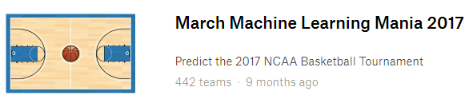
Projects
Participate Kaggle Competitions
Project 1:
Project 2:
To Be Release Later

Slide 4
Grading
Grading Policy
2 Kaggle projects 100%
You must participate in Kaggle competitions to claim the credits

Slide 5
Agenda
Artificial Intelligence
Turing Test
What can AI do today?
What can’t AI do today?
Machine Learning
Definition
Types of Machine Learning
Supervised Learning
Unsupervised Learning
Semi-supervised Learning
Reinforcement Learning
Machine Learning Framework
Data Science and Machine Learning

Slide 6
Artificial Intelligence
Goal of artificial intelligence
Make machines do things that would require intelligence if done by humans
Can machine think?
Vitally important
But “thinking” is hard to define
No simple answer of “Yes” or “No”
A fuzzy answer

Slide 7
What is AI?
Artificial Intelligence
Build machines that imitate human intelligence
Thinking Humanly
Acting Humanly
Thinking Rationally
Acting Rationally
Artificial Intelligence Applications
Perform tasks done by a person
But often faster and at a larger scale

Slide 8
Can a Machine Think?
Goal of artificial intelligence
Make machines do things that would require intelligence if done by humans
Can a machine think?
Vitally important
But “thinking” is hard to define
No simple answer of “Yes” or “No”
A fuzzy answer

Slide 9
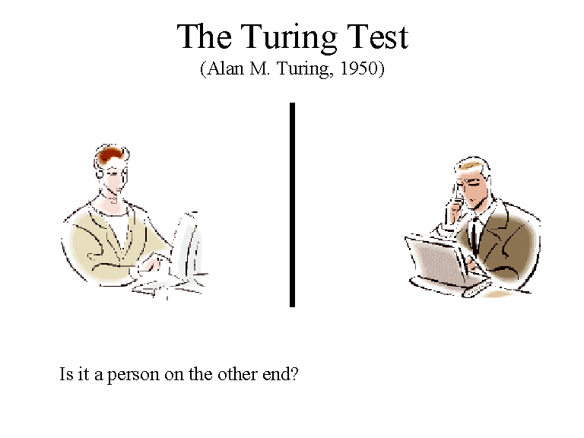
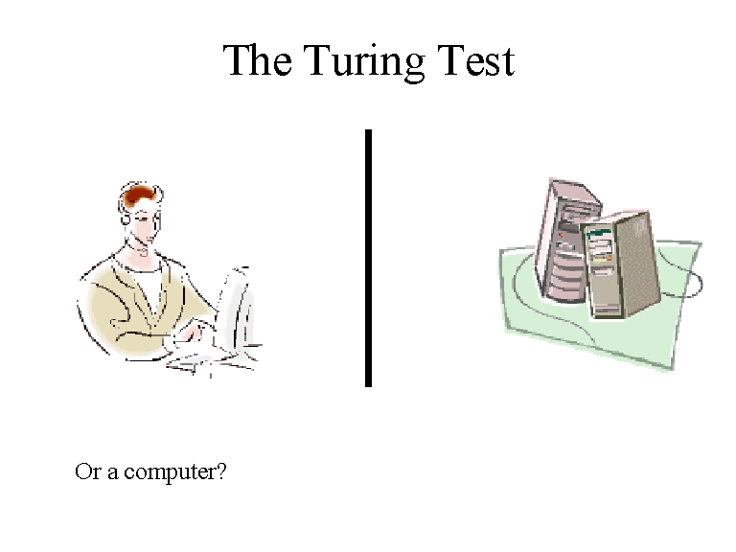
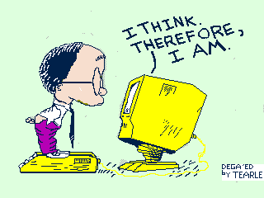
Turing Test
Can a machine pass a behavior test for intelligence?
Turing Test: can a machine appear indistinguishable from a human to an experimenter?

Slide 10
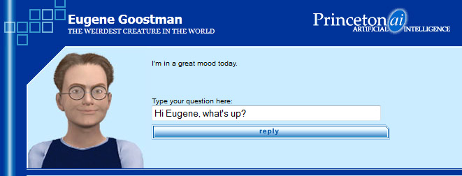
Eugene Goostman
Turing predicted that by year 2000, computers would be intelligent enough to trick humans into thinking they were real 30% of the time.
Eugene Goostman
A Chatterbot
Portrayed as a 13-year old Ukrainian boy
On June 7, 2014, in University of Reading Competition, Eugene convinced 33% contest judges that it is a real boy
“Turing test has been passed for the first time”

Slide 11
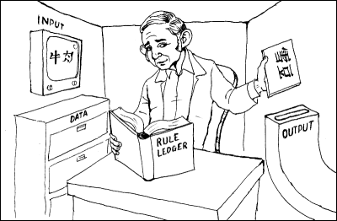
Searle’s Chinese Room Experiment
Does passing Turing test indicate a machine has a mind?
Searle’s Chinese Room Experiment
Locked in a room
Input: Chinese Characters
Processing: Rule book in English
Output: Chinese Characters
Assuming that the output would make sense to a Chinese speaker, does the person inside the room understand Chinese literally?
Yes → “Strong AI”
No → “Weak AI”

Slide 12
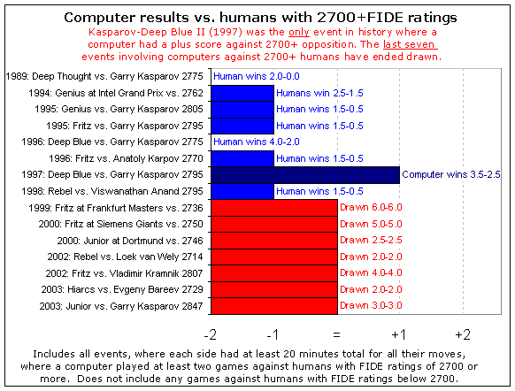
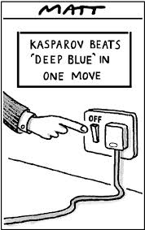
What can AI do today?
Playing Games

Slide 13
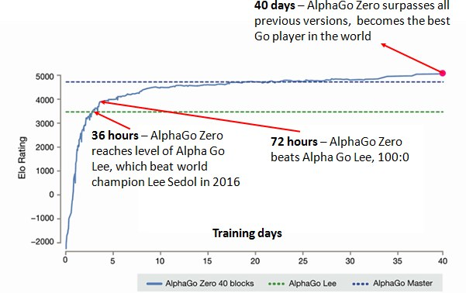
What CAN AI do today?
AlphaGo
Convolutional Neural Network (CNN)
AlphaGo Zero
Adversarial Network
Source: DeepMind

Slide 14
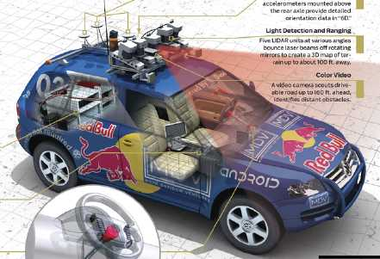
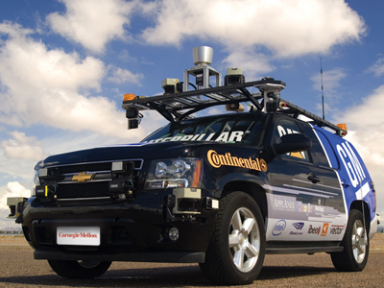
What can AI do today?
Robotics Vehicles
Stanley finished the 132-mile course of rough terrain to win 2005 DARPA grand challenge
CMU’s BOSS won the 2006 Urban challenge
Obey traffic rules and avoid pedestrians and other vehicles

Slide 15
What CAN AI do today?
Image Recognition

Slide 16
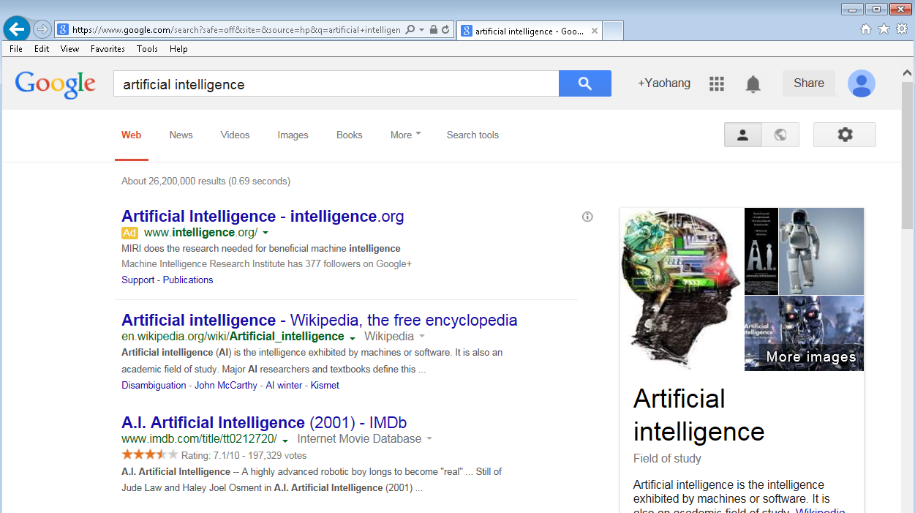
What can AI do today?
AI and Web Search

Slide 17
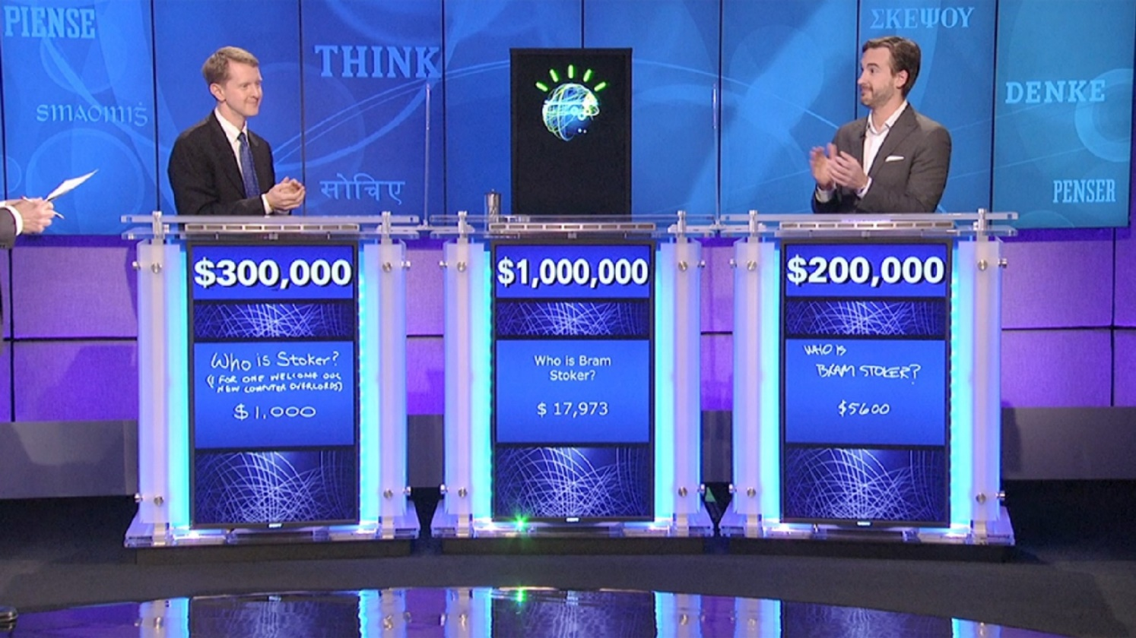
What can AI do today?
IBM’s Watson on Jeopardy
Outperforms Brad Rutter and Ken Jennings in 2011
Natural language processing, information retrieval, knowledge representation, automated reasoning, and machine learning

Slide 18
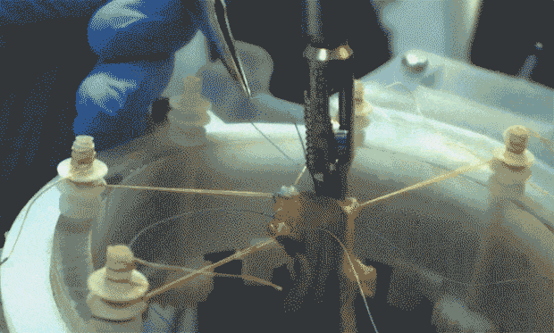
What can AI do today?
STAR (Smart Tissue Autonomous Robot) bests human surgeon
Source: STAR

Slide 19
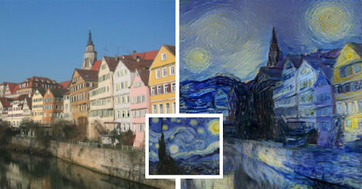
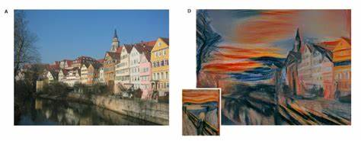
What can AI do today?
Generating virtual arts
http://www.businessinsider.com/robot-can-paint-as-well-as-van-gogh-2015-9

Slide 20
What can AI do today?
Virtual Reality
Source: Metz and Collins, 2018

Slide 21
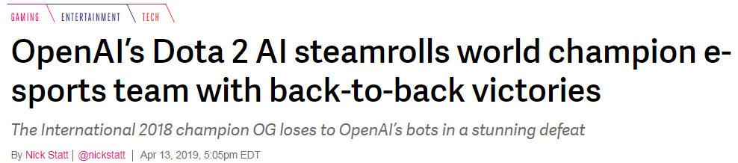
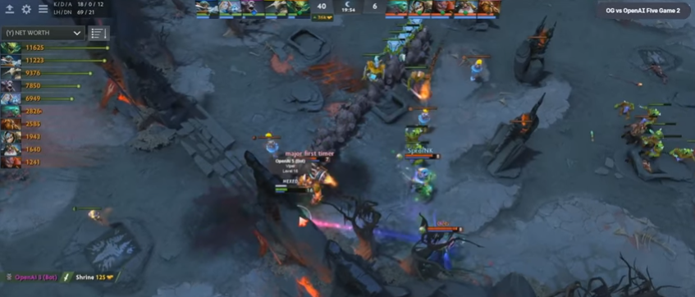
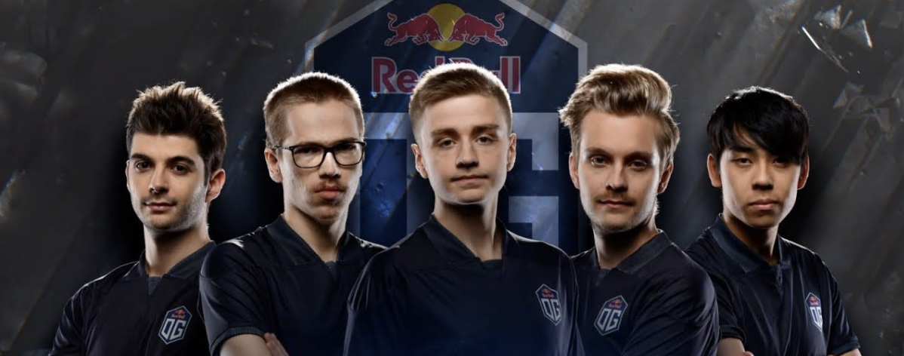
What can AI do today?
Collaborative Games

Slide 22
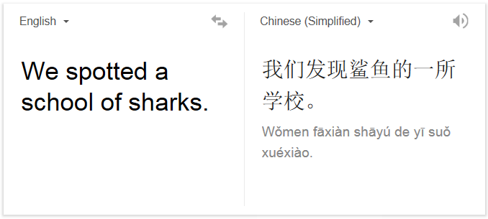
What CAN’T AI do today?
Robust Machine Translation
Example: English to Russian
“The spirit is willing but the flesh is weak” (English)
“The vodka is good but the meat is rotten” (Russian)
Need to translate words and their meaning

Slide 23
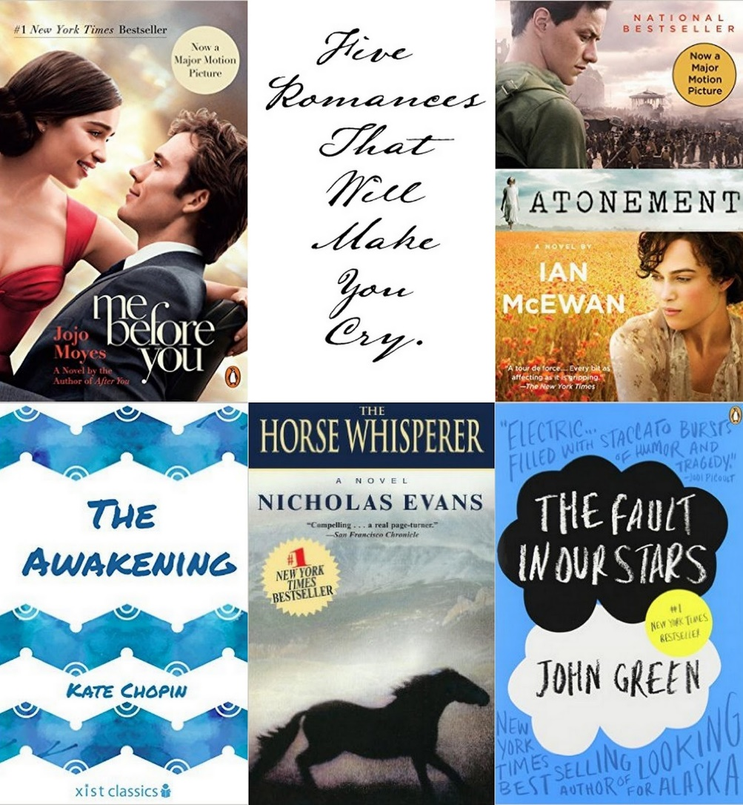
What CAN’T AI do today?
Write an original story that can make you cry

Slide 24

What CAN’T AI do today?
Bug-free Software

Slide 25
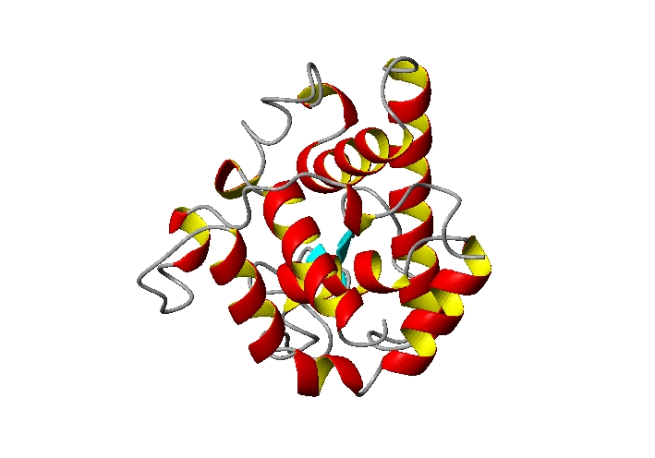
What CAN’T AI do today?
APKFFRGGNWKMNGKRSLGI ELIHTLGDAKLSADTEVVCG PSITEKVVFQETKAIADNDA WSKVEVHESRIYGGSVTNCK ELASQHDVDGFLVGGASLKP VDGFLHALAEGLGVDINAKH ...........
Sequence
Structure
Predicting the 3-D Structure of protein
Grand Challenge with Broad Economic and Scientific Impacts

Slide 26
Agenda
Artificial Intelligence
Turing Test
What can AI do today?
What can’t AI do today?
Machine Learning
Definition
Types of Machine Learning
Supervised Learning
Unsupervised Learning
Semi-supervised Learning
Reinforcement Learning
Machine Learning Framework
Data Science and Machine Learning

Slide 27
What is Machine Learning?
“Learning is any process by which a system improves performance by experience” (Herbert Simon)
Machine learning is the study of algorithms that (Tom Mitchell, 1997)
improve their performance P
at some task T
with experience E
A well-defined learning task is given by <P, T, E>

Slide 28
Machine Learning Tasks
Improve on task T, with respect to performance metric P, based on experience E
T: Playing chess
P: Percentage of games won against an arbitrary opponent
E: Playing practice games against itself
T: Recognizing hand-written words
P: Percentage of words correctly classified
E: Database of human-labeled images of handwritten words
T: Driving on four-lane highways using vision sensors
P: Average distance traveled before a human-judged error
E: A sequence of images and steering commands recorded while observing a human driver.
T: Categorize email messages as spam or legitimate.
P: Percentage of email messages correctly classified.
E: Database of emails, some with human-given labels
Slide credit: R. Mooney

Slide 29
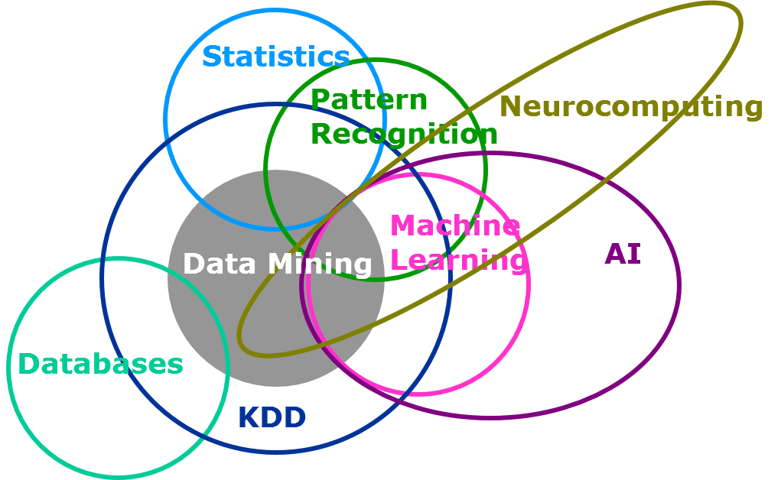
Relation between AI and Machine Learning and Data Science

Slide 30
Programming vs. Machine Learning
Programming
Machine Learning

Slide 31

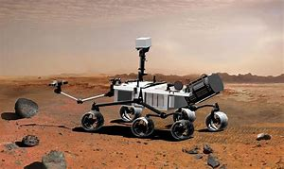
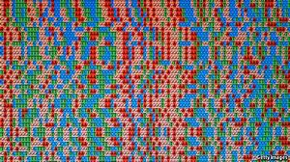
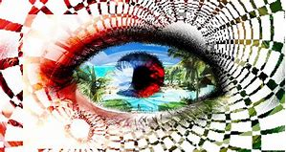
When do we use machine learning?
Human expertise does not exist
Humans can’t explain their expertise
Models must be customized
Models are based on huge amounts of data
navigating on Mars
personalized recommendations
pattern recognition
human genome analysis

Slide 32
When do we use machine learning?
Machine learning is not always useful
There is no need to “learn” to build a calculator
There is no need to “learn” to calculate payroll

Slide 33
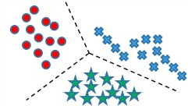
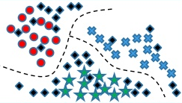
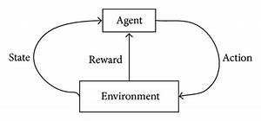
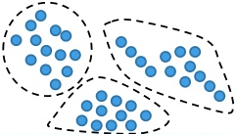
Types of Learning
Supervised (inductive) learning
Given: training data + labels
Unsupervised learning
Given: training data (without labels)
Semi-supervised learning
Given: training data (not all of them have labels)
Reinforcement learning
Rewards from previous actions

Slide 34
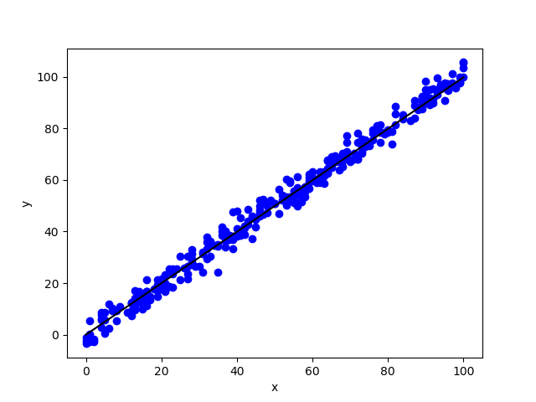
Supervised Learning - Regression
Given (X₁, y₁), (X₂, y₂), ..., (X_{n}, y_{n}), learn a function f(X) to predict y given X
y is real (regression)

Slide 35
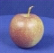
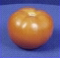
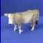
Supervised Learning - Classification
Given (X₁, y₁), (X₂, y₂), ..., (X_{n}, y_{n}), learn a function f(X) to predict y given X
y is categorical (classification)
f( ) = “apple”
f( ) = “tomato”
f( ) = “cow”

Slide 36
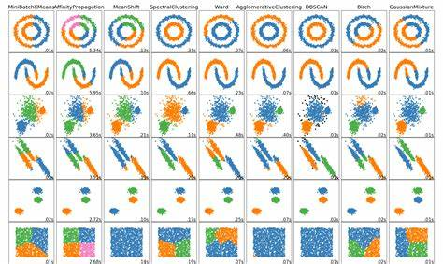
Unsupervised Learning
Given X₁, X₂, ..., X_{n} (without labels), discover the structure under X

Slide 37
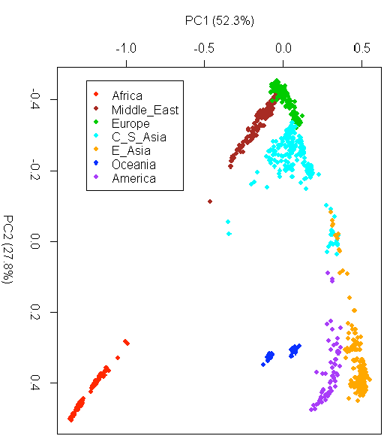
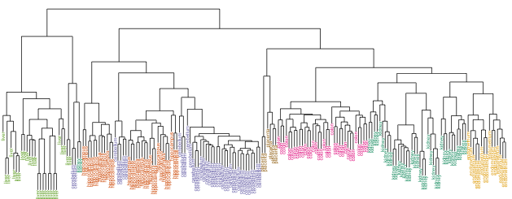
Unsupervised Learning - Human Genome Project Example
Group individuals by genetic similarity
Source: Human Genome Project

Slide 38
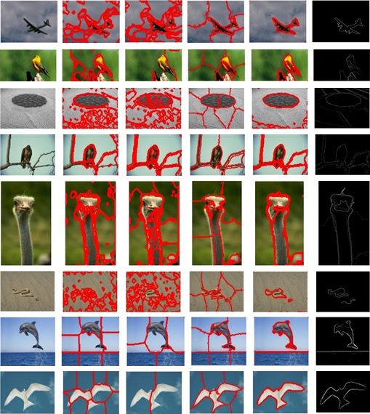
Unsupervised Learning - Image Segmentation

Slide 39
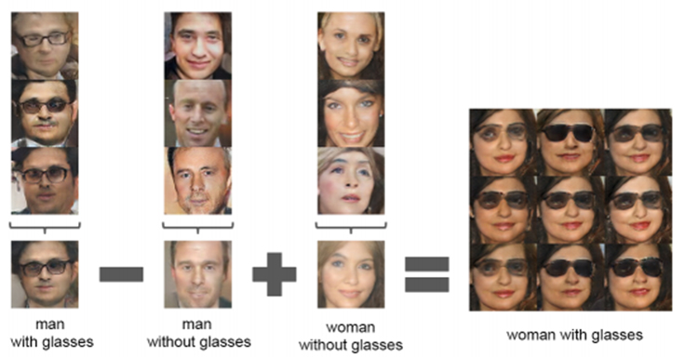
Unsupervised Learning - Distributed Representation
Source: GAN

Slide 40
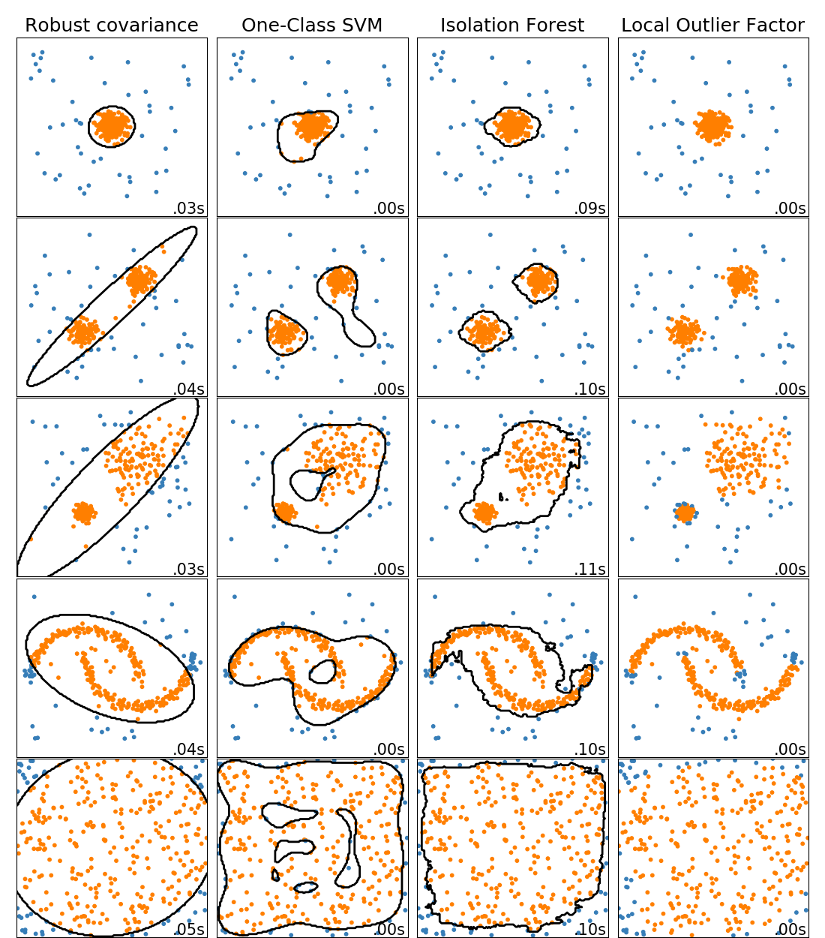
Unsupervised Learning - Outlier Detection

Slide 41
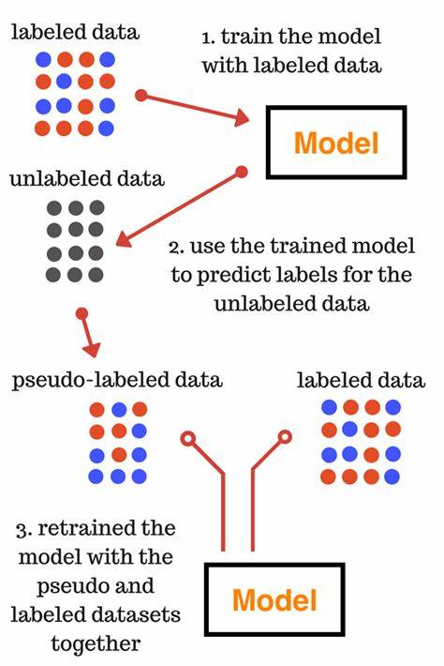
Semi-supervised Learning
In many applications, labeled data is rare
Expensive
Need someone to label it
Require special equipment
Semi-supervised learning
A mix of supervised and unsupervised learning
Take advantage of unlabeled data
Image from analyticsvidhya.com

Slide 42
Semi-supervised Learning - The Netflix Problem

Slide 43
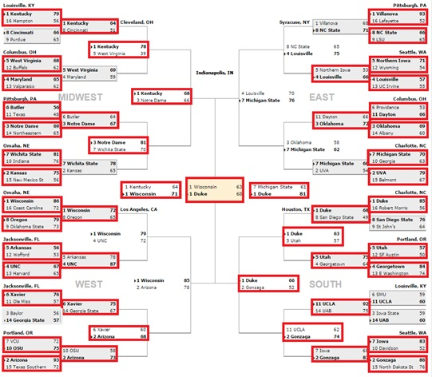
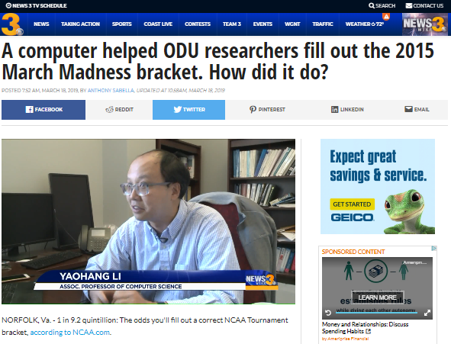
Semi-supervised Learning - March Madness
https://wtkr.com/2019/03/18/a-computer-helped-odu-researchers-fill-out-the-2015-march-madness-bracket-how-did-it-do/

Slide 44
Reinforcement Learning
Given a sequence of states and actions with (delayed) rewards, output a policy
Policy
A mapping from states -> actions that tells you what to do in a given state

Slide 45
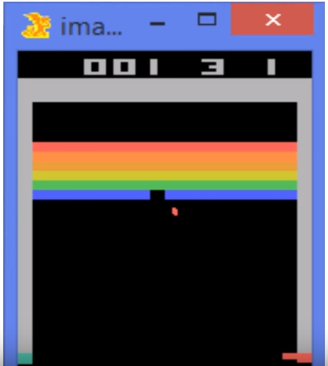
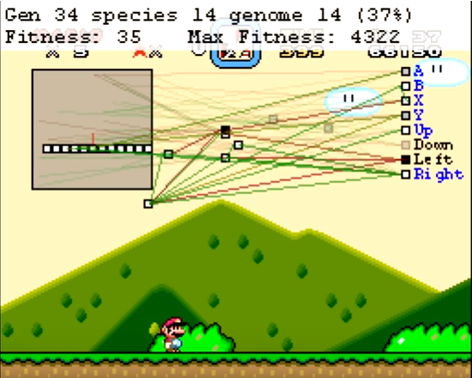
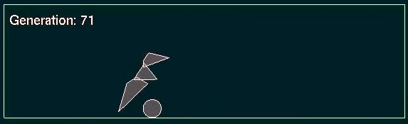
Reinforcement Learning - Game Playing
https://www.youtube.com/watch?v=qv6UVOQ0F44
https://www.youtube.com/watch?v=V1eYniJ0Rnk
Super Mario
Atari Breakout
https://www.youtube.com/watch?v=Gl3EjiVlz_4
Robot Jump

Slide 46
Agenda
Artificial Intelligence
Turing Test
What can AI do today?
What can’t AI do today?
Machine Learning
Definition
Types of Machine Learning
Supervised Learning
Unsupervised Learning
Semi-supervised Learning
Reinforcement Learning
Machine Learning Framework
Data Science and Machine Learning

Slide 47
Machine learning framework
Apply a prediction function to a feature representation of the image to get the desired output f( ) = “apple”
f( ) = “tomato”
f( ) = “cow”
Slide credit: L. Lazebnik

Slide 48
The machine learning framework
y = f(x)
Training: given a training set of labeled samples {(x₁,y₁), …, (x_{N},y_{N})}, estimate the prediction function f by minimizing the prediction error on the training set
Testing: apply f to a never before seen test sample x and output the predicted value y = f(x)
Evaluation: want to know how good the learned model is
output
prediction function
representation
sample
Slide modified from L. Lazebnik

Slide 49

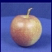
Steps
Training
Training Labels
Training samples
Representation
Training
(optimization)
Evaluation
Testing
Representation
Learned model
Prediction
Test Image
Modified from L. Lazebnik

Slide 50
Machine Learning Algorithms
Many machine learning algorithms available
Hundreds new algorithms every year
Every machine learning algorithm has three components
Representation
Optimization (Minimization)
Evaluation
Slide modified from Pedro Domingos

Slide 51
Representations of Functions
Numerical functions
Linear regression
Neural networks
Support vector machines
Symbolic functions
Decision trees
Rules in propositional logic
Rules in first-order predicate logic
Rules in fuzzy logic
Instance-based functions
Nearest-neighbor
Case-based
Probabilistic Graphical Models
Naïve Bayes
Bayesian networks
Hidden-Markov Models (HMMs)
Probabilistic Context Free Grammars (PCFGs)
Markov networks
Slide modified from Pedro Domingos

Slide 52
Optimization Methods
Gradient descent
Perceptron
Backpropagation
Stochastic Gradient Descent
Dynamic Programming
Monte Carlo
Markov Chain Monte Carlo
Simulated annealing
Parallel tempering
Divide and Conquer
Decision tree induction
Rule learning
Evolutionary Computation
Genetic Algorithms
Genetic Programming
Neuro-evolution
Slide modified from Pedro Domingos

Slide 53
Evaluations
Accuracy
Precision and recall
Convergence
Error (MSE, RMSE, etc.)
Likelihood
Posterior probability
Cost / Utility
Margin
Entropy
K-L divergence
Many others

Slide 54
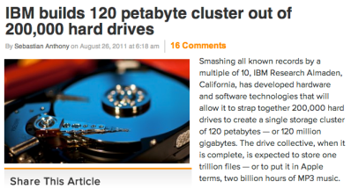
A Lot of Data
1 Zettabyte
1.8 ZB
8.0 ZB
800 EB
Data produced each year
logarithmic scale
161 EB
1 Exabyte
5 EB
120 PB
100-years of HD video + audio
1 Petabyte
Human brain's capacity
60 PB
2002
2006
2009
2011
2015
14 PB
1 Petabyte == 1000 TB

Slide 55


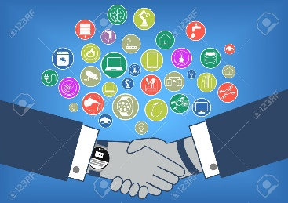
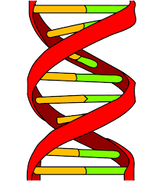


Source of Big Data
Sensors
Social Networks
Business Transactions
Genetics
Physics experiments
Biomedical
Physics Experiments

Slide 56

kaggle

Slide 57
Now it is the BEST time
Time is Right
Better Understanding of Human Cognition
Recent progress in algorithms and theory
Deep Learning
Recommendation Systems
Rapidly growing volume of data from various sources
Available computational power
Large-scale parallel/distributed computing
Growth and interest of AI-based industries
Google, Intel, Amazon, DeepMind, etc.

Slide 58
Summary
Artificial Intelligence
Turing Test
What AI can do and can’t do today?
Machine Learning
Definition
Types of Machine Learning
Machine Learning Framework
Representation
Optimization (Minimization)
Evaluation

Slide 59
Others
Brief introduction to Jupyter Notebook
Brief introduction to Pandas
jupyter notebook intro_pandas
Brief introduction to Matplotlib
jupyter notebook introductiontoplt

